Slide 1
Software Engineering Tools Online Books Borrow(OBB)
Student Preparation:
Feras Sameer Saleem
Doctor:
Khalil Barhoum

Slide 2
Scenario
A typical lending library keeps a stock of books for the use of its members. Each member can take out a number of books, up to a certain limit. After a given period of time, the library expects members to return the books that they have on loan.
When borrowing books members are expected to hand their chosen books to the librarian, who records each new loan before issuing the books to the member. When a book is on loan to a member, it is associated with that member: possession of the book passes from the library to the member for a defined time period. The normal loan period for each book is two weeks. If the member fails to bring the book back on or before the due date, the library imposes a fine.
In a proposed new system, anyone should be able to browse the stock of books held in the library, but only a member will be able to reserve a book.
Tasks you need to carry out
Part 1
Draw a use case diagram for the library system
Draw an activity diagram that represent all the required activities across use cases to complete a loan process.
Write a use case specification for borrow a book use case

Slide 3
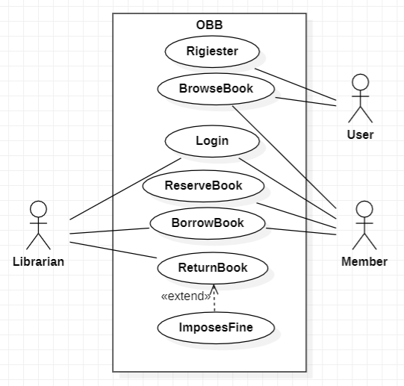
Use-Case Diagrams

Slide 4
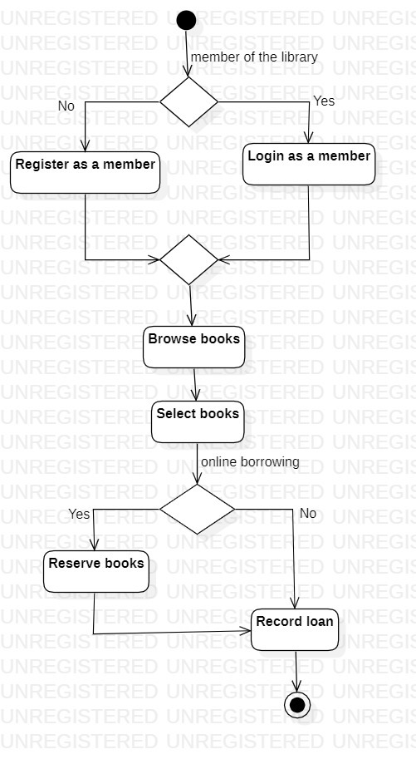
Activity Diagrams

Slide 5
Use-Case Specification
Use Case Number: | UC-03
Use Case Name: | Borrow Books
Actor (s): | Librarian, Member
Summary: | This use case is started by Librarian. It provides the actor to reserve and borrow a book
Basic Course of Events: | The librarian opens the web page The librarian login on the web page The member approaches the librarian with the book they wish to borrow. The librarian checks the availability of the book in the library's stock. If the book is available: a. The librarian records the loan by associating the book with the member. b. The librarian issues the book to the member. The loan period starts from the current date for a maximum period of two weeks
Exception Paths: | E1 If the member fails to bring the book back on or before the due date, the librarian imposes a fine
Extension Points: | {Login}
Triggers: | The librarian Link a book with the member
Assumptions: | The Librarian is aware of the steps required to Borrow a Book.
Preconditions: | The Librarian Login on the system
Post Conditions: | Login to a system
Author (s): | Team3
Date: | 29 – 4 - 2023

Slide 6
Scenario
A typical lending library keeps a stock of books for the use of its members. Each member can take out a number of books, up to a certain limit. After a given period of time, the library expects members to return the books that they have on loan.
When borrowing books members are expected to hand their chosen books to the librarian, who records each new loan before issuing the books to the member. When a book is on loan to a member, it is associated with that member: possession of the book passes from the library to the member for a defined time period. The normal loan period for each book is two weeks. If the member fails to bring the book back on or before the due date, the library imposes a fine.
In a proposed new system, anyone should be able to browse the stock of books held in the library, but only a member will be able to reserve a book.
Tasks you need to carry out
Part 1 Use case modeling (What the system should do)
Draw a use case diagram for the library system
Draw an activity diagram that represent all the required activities across use cases to complete a loan process.
Write a use case specification for borrow a book use case
Part 2 Use case realization( How the system will do it)
Find all participating class in the use case specification you created in part 1 and then distribute the use case behavior on those classes inform of responsibilities.
Draw a VOPC class diagram
Draw a sequence diagram and a collaboration diagram for the basic path in the use case.

Slide 7
participating
Participating Classes:
Library
Member
Book
Librarian
Responsibilities:
Library: Manages the stock of books and loan records.
Member: Requests to borrow a book and returns it within the due date.
Book: Contains information about the book, including its availability.
Librarian: Records loans, checks availability, and issues books to members.

Slide 8
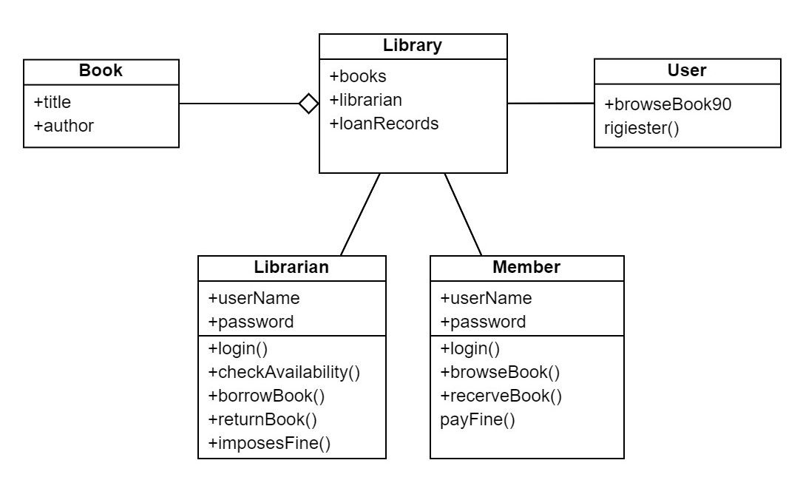
Class Diagrams

Slide 9
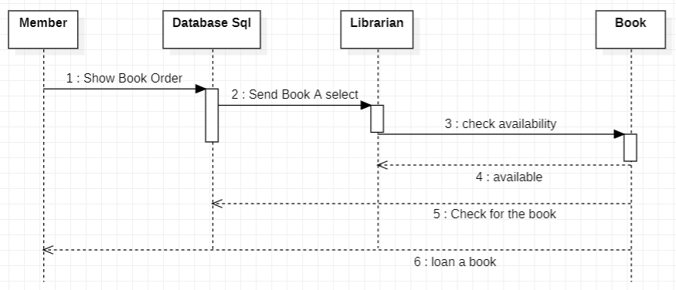
Sequence Diagrams

Slide 10
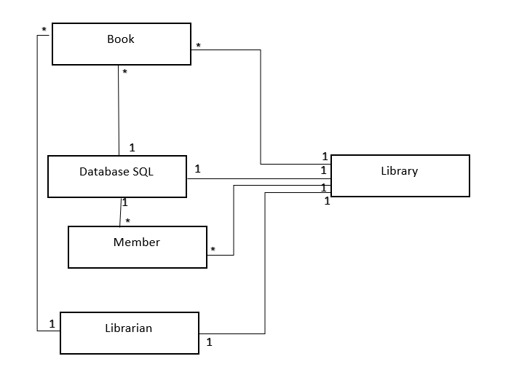
Collaboration Diagrams

